Slide 1
VED ANALYSIS
Dinesh K K V (2133012)
Sathyanand V (2133040)

Slide 2
Contents:
Abstract
Packages & tools used
Problem Statements
Implemntation
Output

Slide 3
Abstract:
This project implements VED (Vital, Essential, and Desirable) analysis for forecasting and categorizing the demand of subcategories in an e-commerce platform. Using Flask, HTML, CSS, and JavaScript, a web-based application is developed to upload sales data, perform ARIMA forecasting, and generate VED analysis results. The results are displayed in a user-friendly interface, including forecasted demand, cumulative demand, percentage demand, and VED category for each subcategory. This project provides businesses with valuable insights for inventory management and decision-making to optimize sales performance.

Slide 4
PACKAGES & TOOLS USED:
Flask
Numpy
Pandas
Matploylib
Statsmodels
Html, Css , Java Script

Slide 5
Flask
Pandas
Numpy
Flask is a web framework used to develop the backend of the application. It handles routing, request handling, and response generation.
pandas is a powerful data manipulation library used for data preprocessing and analysis. It is used to load the uploaded CSV file, perform data cleaning, and perform grouping and aggregation operations.
numpy is a library for numerical computing in Python. It is used for handling numerical operations and working with arrays.

Slide 6
Matplotlib:
Statsmodels:
HTML/CSS/ JavaScript:
matplotlib is a plotting library used for creating visualizations. It is used to generate pie charts to represent the VED analysis results.
statsmodels is a library for statistical modeling and analysis. It is used to fit an ARIMA model for demand forecasting.
These are the standard web technologies used for designing and creating the user interface. HTML is used to structure the web pages, CSS is used for styling and layout, and JavaScript is used to add interactivity to the web application.

Slide 7
PROBLEM STATEMENT:
The problem addressed in this project is the efficient management of inventory in an e-commerce platform. By applying VED (Vital, Essential, and Desirable) analysis to forecast demand and categorize subcategories, the aim is to identify critical products (Vital), prioritize essential items (Essential), and optimize stock levels for desirable products (Desirable). This project leverages Flask, HTML, CSS, and JavaScript to create a user-friendly web application that enables businesses to upload sales data, perform demand forecasting, and obtain actionable insights for inventory management, ultimately improving sales performance and customer satisfaction.

Slide 8
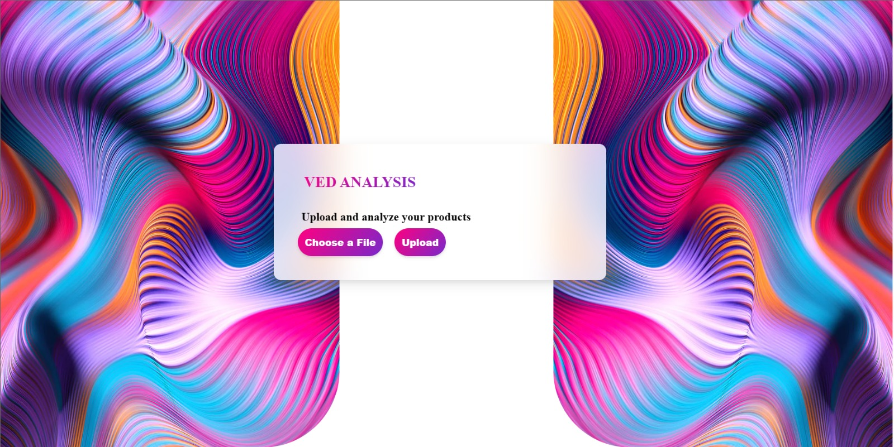
OUTPUT:

Slide 9
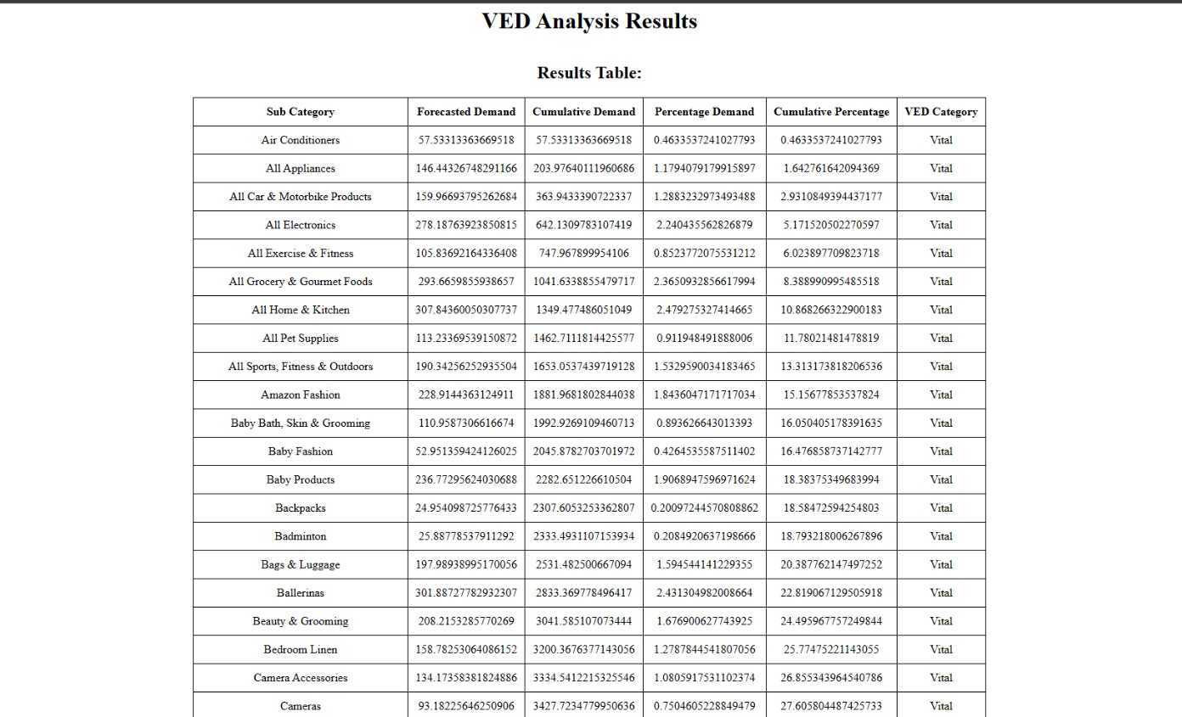

Slide 10
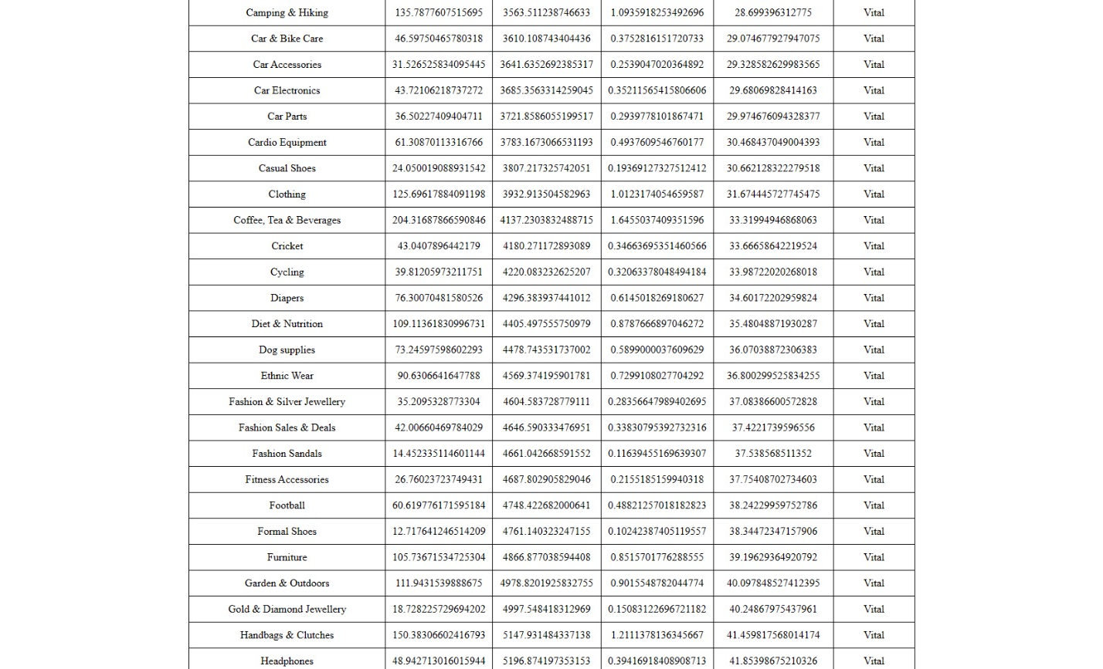

Slide 11
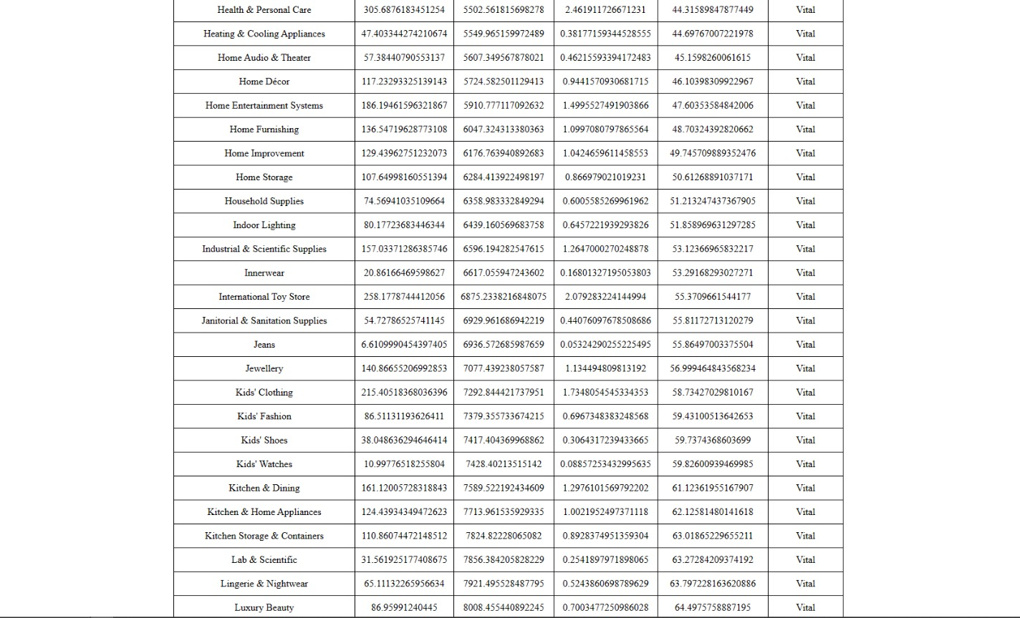

Slide 12
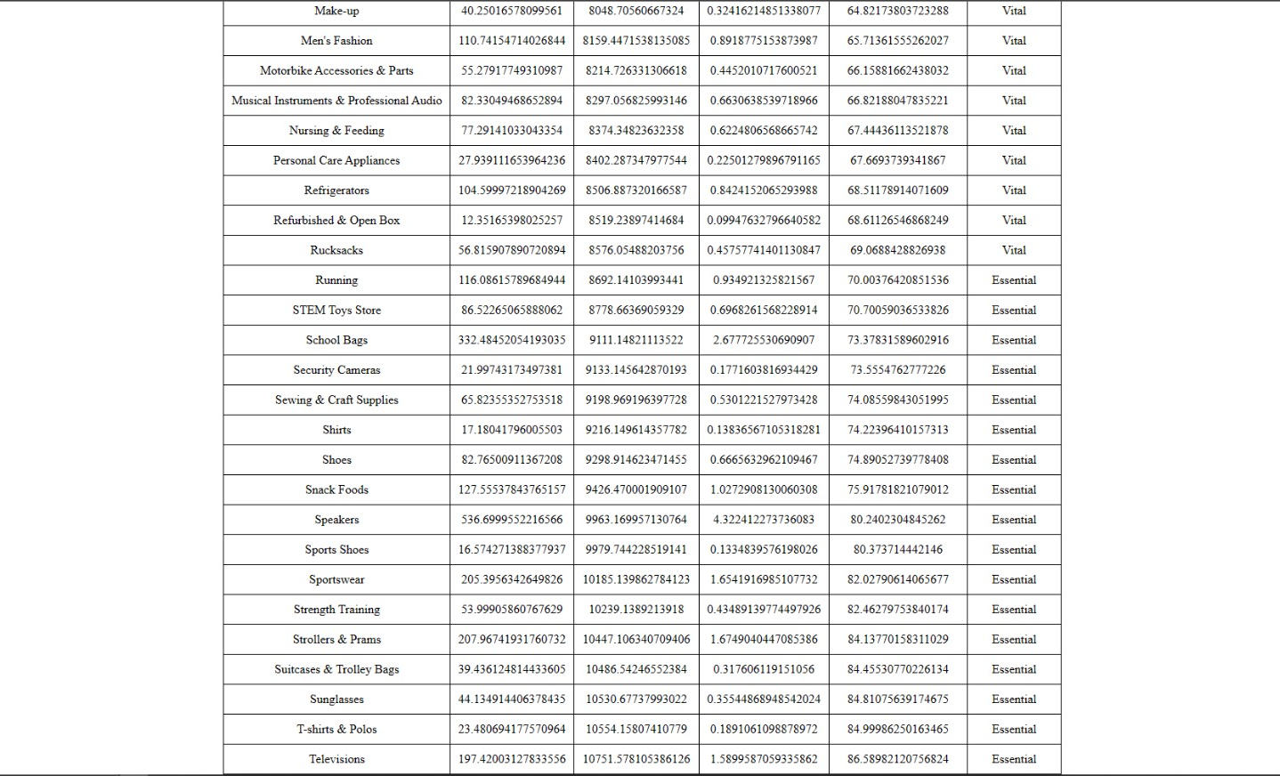

Slide 13
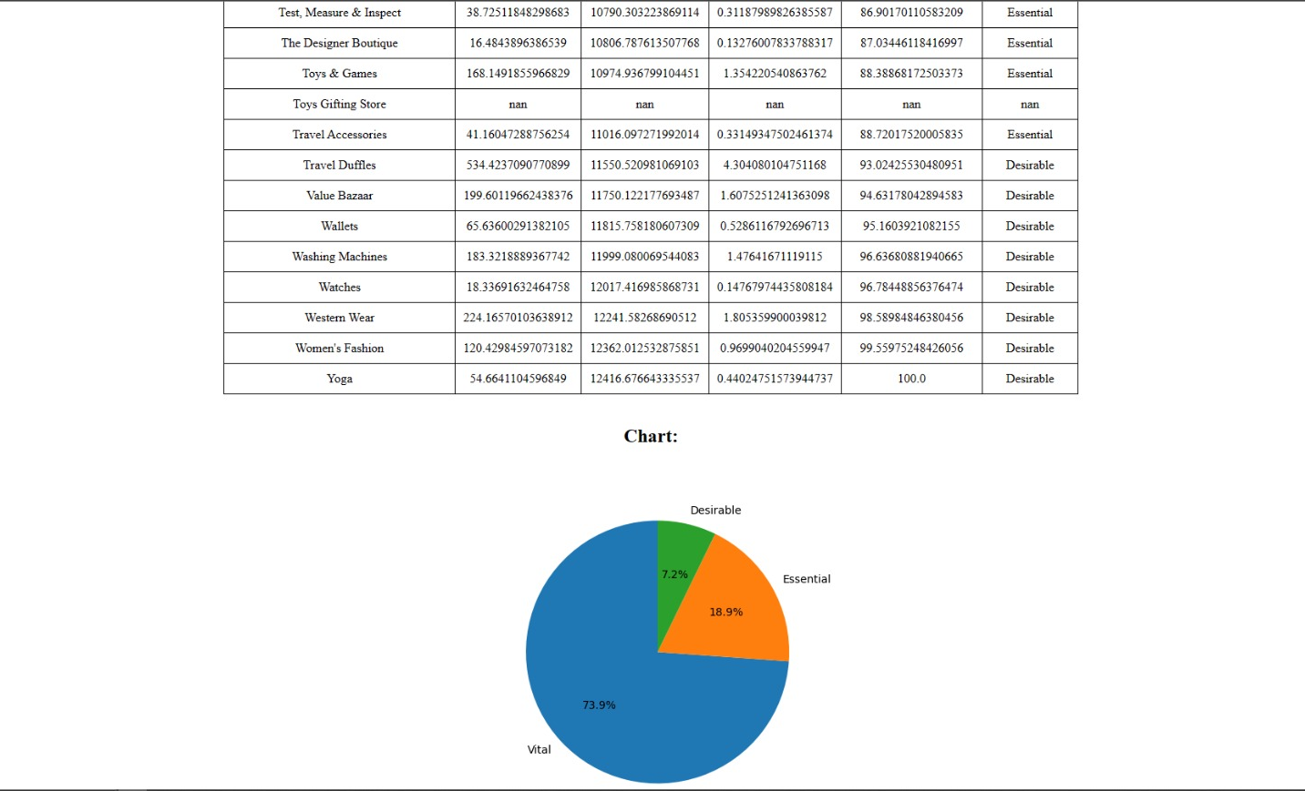

Slide 14
Thank You

